Slide 1
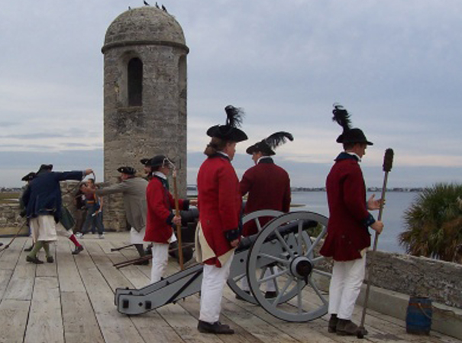
British Florida 1763-1783

Slide 2
Florida in the Revolutionary War
After the French and Indian War, The British were awarded Spanish La Florida which was divided into 2 colonies.

Slide 3
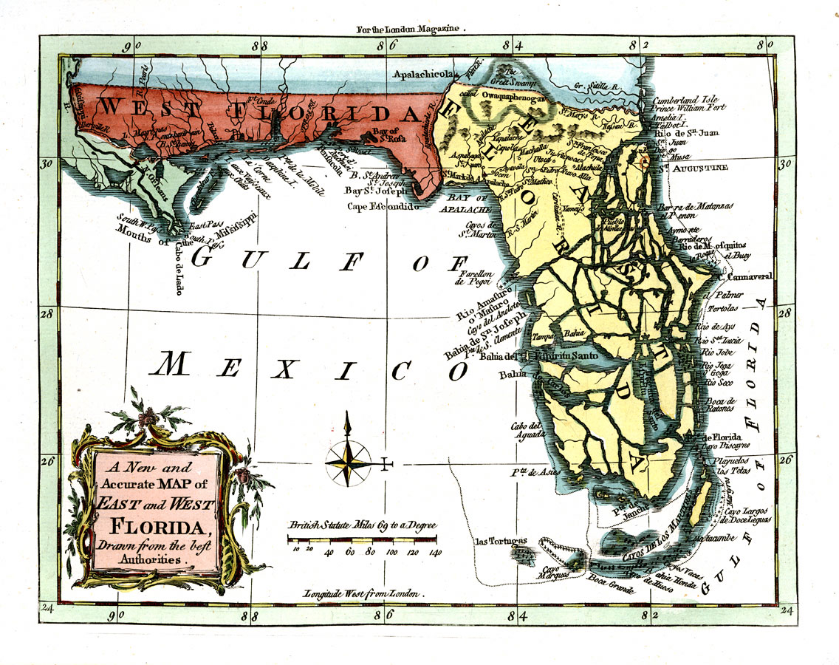

Slide 4
Florida in the Revolutionary War
The colonies of East Florida, West Florida, Ireland, the Bahamas, and Quebec were asked to join the Continental Congress.

Slide 5
Florida in the Revolutionary War
The colonies of East Florida, West Florida, Ireland, the Bahamas and Quebec were asked to join the Continental Congress.
They all refused.

Slide 6
FLORIDA WAS LOYAL TO BRITAIN BECAUSE:
Britain encouraged people to settle in the Floridas.

Slide 7
FLORIDA WAS LOYAL TO BRITAIN BECAUSE:
Britain encouraged people to settle in the Floridas.
The Floridas relied heavily on trade with Britain

Slide 8
FLORIDA WAS LOYAL TO BRITAIN BECAUSE:
Britain encouraged people to settle in the Floridas.
The Floridas relied heavily on trade with Britain.
Britain used Florida as a staging area for attacking the southern colonies

Slide 9
Florida in the Revolutionary War
Population of the Florida colonies swells during the war
4,000 in 1775
17,000 in 1781

Slide 10
Florida in the Revolutionary War
Population of the Florida colonies swells during the war
St. Augustine becomes a haven for Loyalists and refugees

Slide 11
Florida in the Revolutionary War
Population of the Florida colonies swells during the war
St. Augustine becomes a haven for Loyalists and refugees
St. Augustine becomes home to the King’s 60th Regiment during the war

Slide 12
Florida in the Revolutionary War
East Florida Rangers
Florida militia volunteers
Protected East Florida from Patriot attacks
Invaded Georgia in 1778

Slide 13
Florida in the Revolutionary War
East Florida
One major Patriot attack in the war
1777 one hundred Patriots easily defeated at Thomas Creek (Jacksonville)
Used Guerilla attacks because the terrain was unsuitable to British Redcoat-style fighting

Slide 14
Florida in the Revolutionary War
West Florida
Spain invaded the Capital of West Florida, Pensacola
Reason why Florida was given back to Spain

Slide 15
Florida in the Revolutionary War
Britain gave Florida Loyalists land in the Bahamas after the war ended

